Slide 1

Arduino/C++ Workshop
ECU Robotics Society – Keegan Barnard, Jessica Dippenaar

Slide 2
Today’s Session - Friday
9am- Using IR remote, controlling a dc motors direction and speed using a remote
12-1pm - Lunch
1-3pm – Design Project (Turn on DC motor (fan) when humidity reaches a certain point)

Slide 3
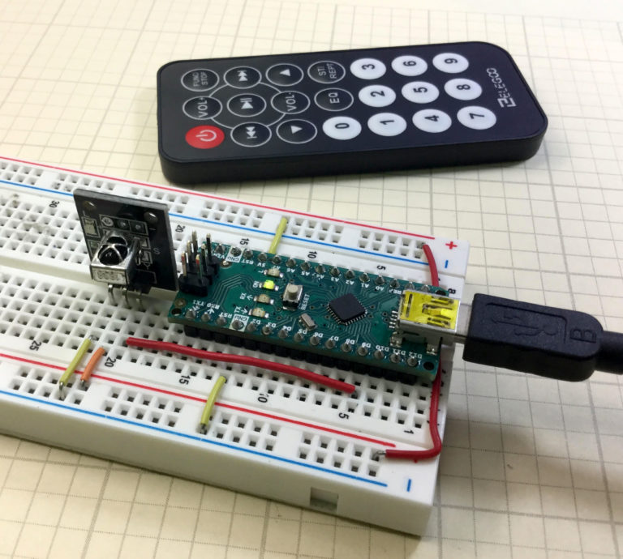
LR Sensor
Be mindful of the placement – we are adding more components onto the board in the later project
G = Ground
R= Positive
Y= PWM Signal Pin
Download “IRRemote” Library

Slide 4
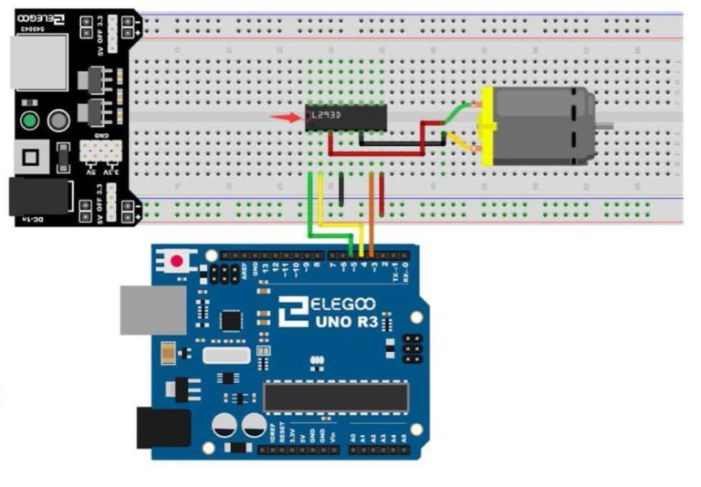
Motor controlled by remote – add ir sensor

Slide 5
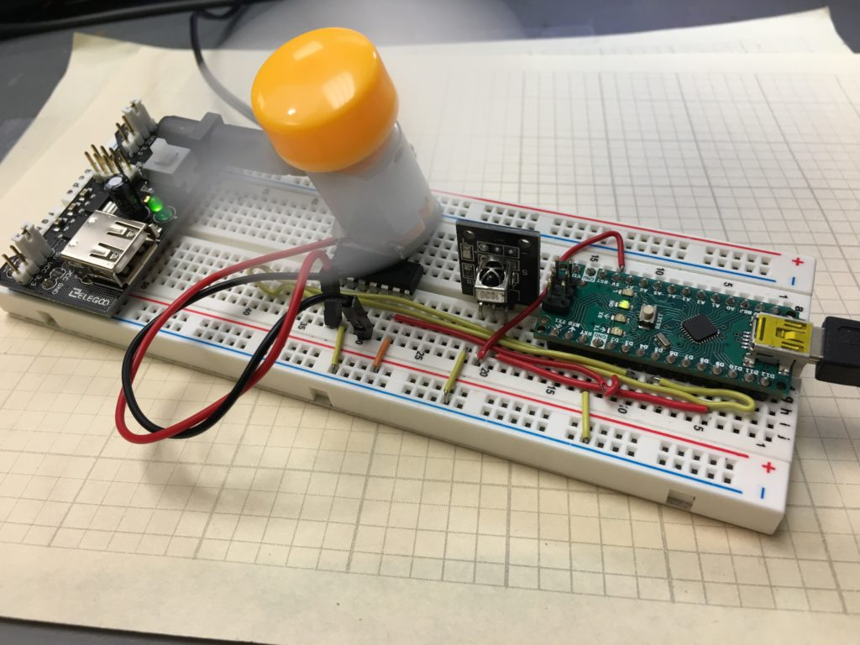
Task Overview
L2930 motor controller
Arduino Uno (Image shows Arduino Nano – works nicer when making prototype like work.
Power board
9V Battery
DHT Sensor
Motor

